Slide 1
AutoInspect AI - Intelligent Vehicle Damage Assessment System
CAPSTONE PROJECT
Presented By:
Student Name- Pratyush Malik
College Name- Edunet Foundation
Department- M.Sc.
4. AICTE ID- STU6a0e8ee2ef7a31779338978

Slide 2
OUTLINE
Problem Statement (Should not include solution)
Proposed System/Solution
System Development Approach (Technology Used)
Algorithm & Deployment
Result
Conclusion
Future Scope
References

Slide 3
Problem Statement
Vehicle damage assessment is often a time-consuming and subjective process that requires manual inspection by a skilled person, making it difficult for vehicle owners, insurance companies, and service centers to quickly identify and understand visible damage. The Vehicle Damage Analyzer aims to address this problem by developing an AI-powered application that uses multimodal Generative AI to analyze an uploaded vehicle image and identify visible damage such as scratches, dents, cracks, and broken components. The system provides information about the damaged area, type of damage, apparent severity, and potential safety concerns, helping users obtain a quick and structured preliminary assessment without requiring immediate manual inspection.

Slide 4
SYSTEM DEVELOPMENT APPROACH
Hardware Requirements
Computer / Laptop
Minimum 4 GB RAM recommended
Stable Internet Connection
Web Browser
Software Requirements
Python
Streamlit
Google Gemini API
Pillow (PIL)
Python IDE / VS Code
Modern Web Browser

Slide 5
TECHNOLOGY STACK
Component | Technology
Programming Language | Python
Frontend / UI | Streamlit
AI Model | Gemini 2.5 Flash
AI API | Google Gemini API
Image Processing | Pillow
Development Environment | VS Code / Python IDE

Slide 6
Proposed Solution
Upload a vehicle image through a Streamlit interface.
Send the image and analysis prompt to Gemini 3.6 Flash.
Identify visible damage such as scratches, dents, cracks, and broken components.
Identify the approximate location of the damage.
Classify apparent severity as Minor, Moderate, or Severe.
Highlight potential visible safety concerns.
Suggest components that may require professional inspection.
Generate a structured damage assessment report.

Slide 7
System Approach
Vehicle Image
↓
Image Upload
↓
Image Processing
↓
Gemini 3.6 Flash
↓
Multimodal Analysis
↓
Damage Identification
↓
Structured Assessment
↓
Result Display

Slide 8
Algorithm & Deployment
Algorithm
The application uses multimodal Generative AI rather than a traditionally trained image-classification model.
User uploads a vehicle image.
The image is opened using PIL.
A carefully designed prompt defines the required analysis.
Image + prompt are sent to Gemini 2.5 Flash.
Gemini analyzes the visual information.
The model identifies visible damage and its characteristics.
The generated response is displayed through Streamlit.
Deployment
Application Framework: Streamlit
Model Access: Gemini API
Deployment Options: Streamlit Cloud / Hugging Face Spaces
Input: JPG, JPEG, PNG vehicle images
Output: AI-generated vehicle damage report

Slide 9
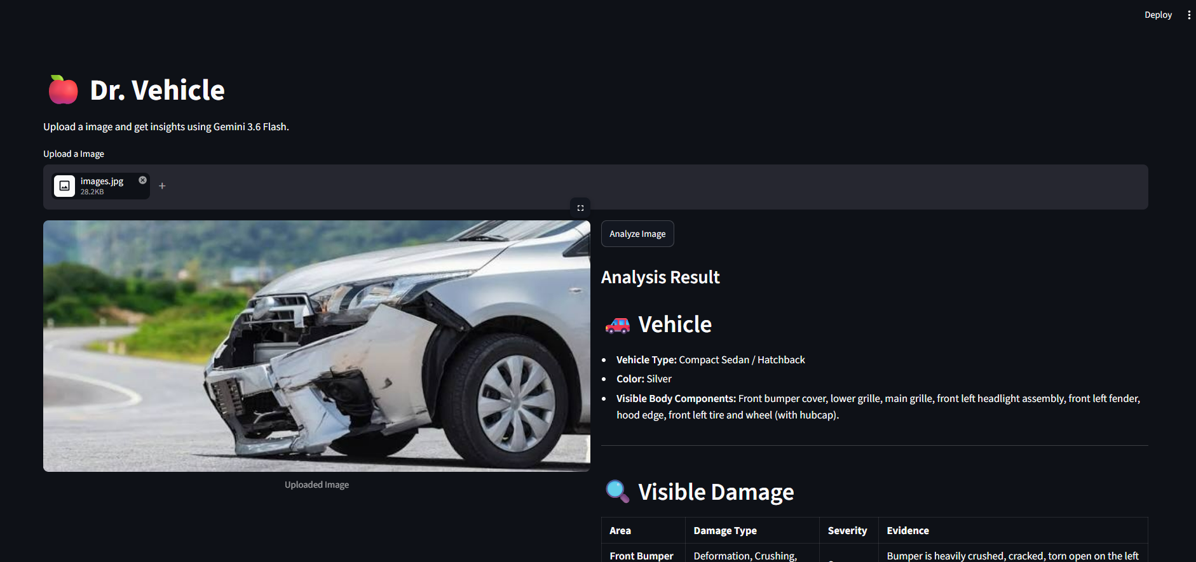
Result

Slide 10
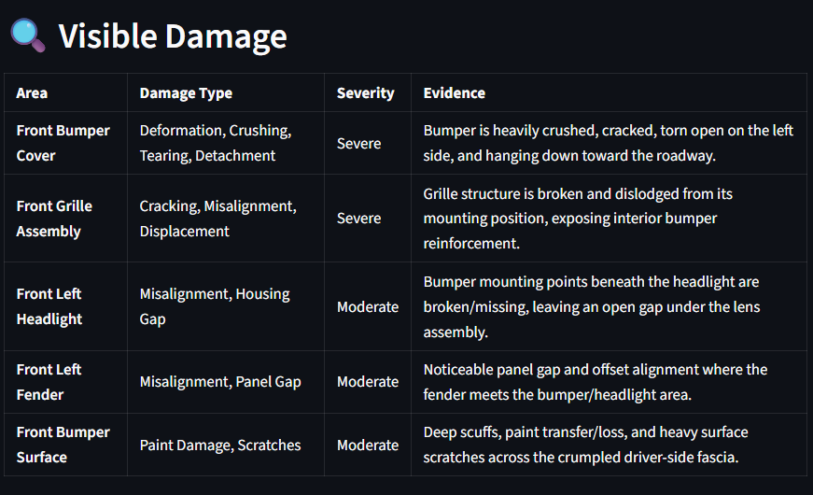
Result

Slide 11
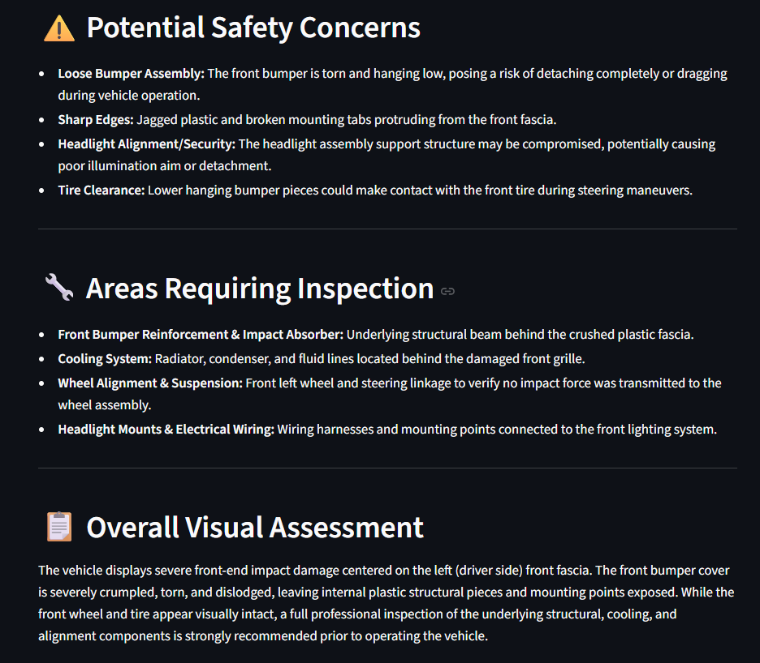
Result

Slide 12
Conclusion
The AI-Powered Vehicle Damage Analyzer demonstrates how multimodal Generative AI can be used to perform preliminary vehicle damage analysis from images. The application provides a fast and user-friendly way to identify visible damage, categorize its apparent severity, and highlight areas that may require professional inspection. The project also demonstrates the practical use of Gemini 3.6 Flash, prompt engineering, image understanding, Python, and Streamlit in developing a real-world Generative AI application.

Slide 13
Future scope
The system can be enhanced with several advanced capabilities:
Repair Cost Estimation based on damage type and severity.
Damage Localization using bounding boxes or segmentation.
Damage Severity Scoring using a standardized scoring system.
Multiple Vehicle Support including cars, bikes, trucks, and other vehicles.
Multiple Image Analysis from different angles.
Automated Insurance Report Generation.
Integration with Vehicle Service Centers.
Development of a mobile application.
Integration with specialized computer-vision models for more precise damage detection.

Slide 14
References
Google Gemini / Gemini API Documentation – Multimodal Generative AI and image understanding.
Streamlit Documentation – Development and deployment of Python-based web applications.
Python Documentation – Python programming language and standard libraries.
Pillow (PIL) Documentation – Image processing and manipulation.
Google Generative AI Documentation – API integration and Generative AI model usage.
Relevant research literature on computer vision, vehicle damage detection, and automated visual inspection.
GitHub
The Python Standard Library — Python 3.14.6 documentation

Slide 15
Deployment link / github link
Github Link: https://github.com/pratyusmalik-tech/AI-Vehicle-Management-Analyser.git
Deployment: https://ai-vehicle-management-analyser-b8fwue4m52vcnj6jpofzvi.streamlit.app/
Streamlit

Slide 16
THANK YOU

